Slide 1
Cornerstone City Church Peninsula Plus Community Hoo Are Ya
24th August 2025

Slide 2
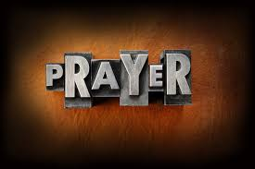

Slide 3
Great Big God
CCLI Song # 3373437
Jo Hemming | Nigel Hemming
© 2001 Vineyard Songs (UK/Eire) (Admin. by Integrity Music Ltd)
For use solely with the SongSelect® Terms of Use. All rights reserved. www.ccli.com
CCLI Licence No. 33265

Slide 4
1/2
Our God is a great big God
Our God is a great big God
Our God is a great big God
And He holds us in His hands

Slide 5
2/2
He's higher than a skyscraper
And He's deeper than a submarine
He's wider than the universe
And beyond my wildest dreams
And He's known me and He's loved me
Since before the world began
How wonderful to be a part of
God's amazing plan

Slide 7
Hosanna (Praise Is Rising)
CCLI Song # 4662491
Brenton Brown | Paul Baloche
© 2005, 2006 Integrity's Hosanna! Music (Admin. by Integrity Music Ltd)
Thankyou Music (Admin. by Integrity Music Ltd)
For use solely with the SongSelect® Terms of Use. All rights reserved. www.ccli.com
CCLI Licence No. 33265

Slide 8
1/6
Praise is rising
Eyes are turning to You
We turn to You
Hope is stirring
Hearts are yearning for You
We long for You

Slide 9
2/6
‘Cause when we see You
We find strength to face the day
In Your presence
All our fears are washed away
(Washed away)

Slide 10
3/6
Hosanna Hosanna
You are the God who saves us
Worthy of all our praises
Hosanna Hosanna
Come have Your way among us
We welcome You here Lord Jesus

Slide 11
4/6
Hear the sound of
Hearts returning to You
We turn to You
In Your Kingdom
Broken lives are made new
You make us new

Slide 12
5/6
‘Cause when we see You
We find strength to face the day
In Your presence
All our fears are washed away
(Washed away)

Slide 13
6/6
Hosanna Hosanna
You are the God who saves us
Worthy of all our praises
Hosanna Hosanna
Come have Your way among us
We welcome You here Lord Jesus

Slide 14
Praise
CCLI Song # 7213077
© Brandon Lake MusicFor Humans PublishingMaverick City PublishingCapitol CMG GenesisCapitol CMG ParagonHousefires SoundsWriter's Roof PublishingMusic by Elevation Worship Publishing
For use solely with the SongSelect® Terms of Use. All rights reserved. www.ccli.com
Note: Reproduction of this sheet music requires a CCLI Music Reproduction Licence. Please report all copies.
CCLI Licence No. 33265

Slide 15
1/12
Let everything that has breath
Praise the Lord
Praise the Lord

Slide 16
2/12
I’ll praise in the valley
Praise on the mountain
I’ll praise when I’m sure
Praise when I’m doubting

Slide 17
3/12
I’ll praise when outnumbered
Praise when surrounded
'Cause praise is the water
My enemies drown in

Slide 18
4/12
As long as I’m breathing
I’ve got a reason to Praise the Lord oh my soul
Praise the Lord oh my soul

Slide 19
5/12
I’ll praise when I feel it
And I’ll praise when I don’t
I’ll praise 'cause I know
You’re still in control

Slide 20
6/12
'Cause my praise is a weapon
It’s more than a sound
My praise is the shout
That brings Jericho down

Slide 21
7/12
As long as I’m breathing
I’ve got a reason to Praise the Lord oh my soul
Praise the Lord oh my soul

Slide 22
8/12
I won’t be quiet
My God is alive
How could I keep it inside
Praise the Lord oh my soul

Slide 23
9/12
I’ll praise 'cause You’re sovereign
Praise 'cause You reign
Praise 'cause You rose and defeated the grave
I’ll praise 'cause You’re faithful
Praise 'cause You’re true
Praise 'cause there’s nobody greater than You

Slide 24
10/12
Praise the Lord oh my soul
Praise the Lord oh my soul
Praise the Lord oh my soul
Praise the Lord oh my soul
I won’t be quiet
My God is alive
How could I keep it inside

Slide 25
1 1/12
I won’t be quiet
My God is alive
How could I keep it inside
I won’t be quiet
My God is alive
How could I keep it inside
Praise the Lord oh my soul

Slide 26
12/12
Let everything that has breath
Praise the Lord
Praise the Lord

Slide 28
Thanksgiving
CCLI Song # 7199589
Nick Herbert | Taku Mudere | Zo Chilengwe
© Capitol CMG Genesis; Safe and Sound Music; Remaining portion is unaffiliated
For use solely with the SongSelect® Terms of Use. All rights reserved. www.ccli.com
CCLI Licence No. 33265

Slide 29
1/10
Enter in (Enter in)
His courts with praise (His courts with praise)
For He is greatly (He is greatly)
To be praised (To be praised)

Slide 30
2/10
Enter in (Enter in)
His courts with praise (His courts with praise)
For He is greatly (He is greatly)
To be praised

Slide 31
3/10
What shall we do
We shall lift up a shout
What shall we do
We shall praise Him
What shall we do
For our God made a way
We'll give Him our thanksgiving

Slide 32
4/10
Magnify (Magnify)
His Holy Name (His Holy Name)
For He is greatly (For He is greatly)
To be praised (To be praised)

Slide 33
5/10
Magnify (Magnify)
His Holy Name (His Holy Name)
For He is greatly (For He is greatly)
To be praised

Slide 34
6/10
What shall we do
We shall lift up a shout
What shall we do
We shall praise Him
What shall we do
For our God made a way
We'll give Him our thanksgiving

Slide 35
7/10
Even if the rocks cry out
We're gonna drown them out
With a louder shout of praise
Even when the battles roar
We're gonna praise You Lord
'Cause You are always worthy

Slide 36
8/10
You are worthy
Worthy of honour and praise
You are worthy
We'll sing it again and again

Slide 37
9/10
What shall we do
We shall lift up a shout
What shall we do
We shall praise Him
What shall we do
For our God made a way
We'll give Him our thanksgiving

Slide 38
10/10
We'll give Him our thanksgiving
We'll give Him our thanksgiving

Slide 40
King of Kings
CCLI Song # 7127647
Brooke Ligertwood | Jason Ingram | Scott Ligertwood
© 2019 Fellow Ships Music (Admin. by Essential Music Publishing LLC)
So Essential Tunes (Admin. by Essential Music Publishing LLC)
Hillsong Music Publishing Australia (Admin. by Hillsong Music Publishing UK)
For use solely with the SongSelect® Terms of Use. All rights reserved. www.ccli.com
CCLI Licence No. 33265

Slide 41
1/11
In the darkness we were waiting
Without hope without light
Till from Heaven You came running
There was mercy in Your eyes

Slide 42
2/11
To fulfil the law and prophets
To a virgin came the Word
From a throne of endless glory
To a cradle in the dirt

Slide 43
3/11
Praise the Father
Praise the Son
Praise the Spirit three in one
God of Glory
Majesty
Praise forever to the King of kings

Slide 44
4/11
To reveal the kingdom coming
And to reconcile the lost
To redeem the whole creation
You did not despise the cross

Slide 45
5/11
For even in Your suffering
You saw to the other side
Knowing this was our salvation
Jesus for our sake You died

Slide 46
6/11
Praise the Father
Praise the Son
Praise the Spirit three in one
God of Glory
Majesty
Praise forever to the King of kings

Slide 47
7/11
And the morning that You rose
All of heaven held its breath
Till that stone was moved for good
For the Lamb had conquered death

Slide 48
8/11
And the dead rose from their tombs
And the angels stood in awe
For the souls of all who'd come
To the Father are restored

Slide 49
9/11
And the Church of Christ was born
Then the Spirit lit the flame
Now this Gospel truth of old
Shall not kneel shall not faint

Slide 50
10/11
By His blood and in His Name
In His freedom I am free
For the love of Jesus Christ
Who has resurrected me

Slide 51
11/11
Praise the Father
Praise the Son
Praise the Spirit three in one
God of Glory
Majesty
Praise forever to the King of kings

Slide 52
1/4
Praise the Lord with me
Lift your voice and sing
'Cos there is no one like Him
Jesus our King

Slide 53
2/4
I bless Your Name in the morning
I bless Your Name in the evening
I bless Your Name in the morning
Every chance I get I bless Your name

Slide 54
3/4
Come on and praise the Lord with me
Sing if you love His name
Come on and lift your voice with me
He’s worthy of all our praise

Slide 55
4/4
Come on and bring your offering
Sing if you’ve known His grace
Come on and lift up your holy hands
He’s worthy of all our praise He’s worthy of all our praise

Slide 56


Slide 57
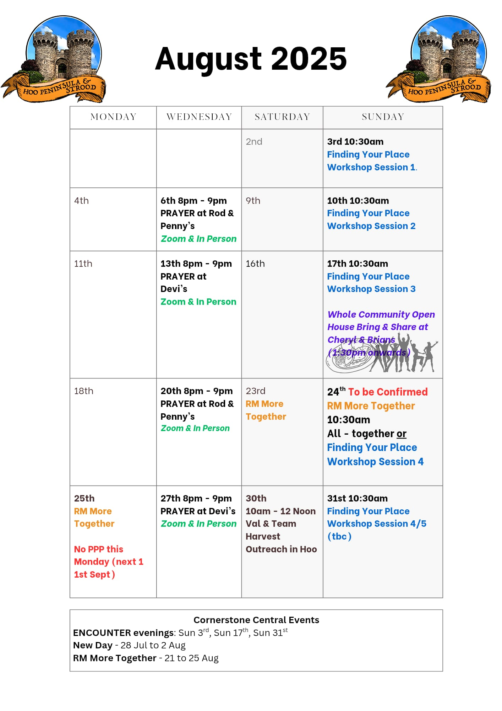

Slide 58


Slide 59

Grow Group 1
On YOUR MARK!

Slide 60
Leaders
Leaderss
Phil & Kim
Maria (Mia) Warren
Matthew Harrison
Richard & Elisha Acheampong
Phil & Kim
Maria (Mia) Warren
Matthew Harrison
Richard & Elisa Acheampong

Slide 61
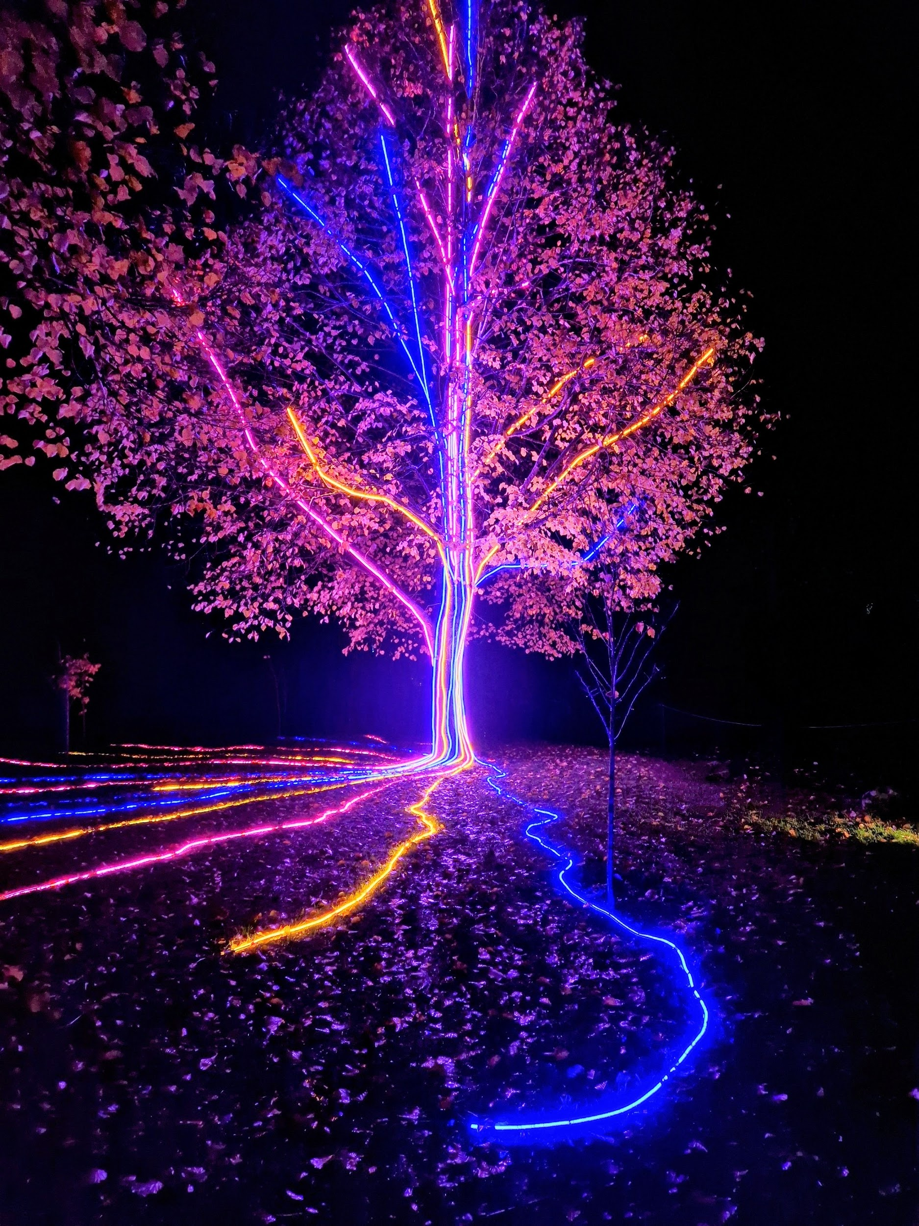
Storm Walker
Storm Walker
Symbolising, trust in Jesus Christ through life's storms.
Mark 4:35-41

Slide 62



Group Leaders
Micheal and Mwamba
Wilfred and Parveen
Hannah

Slide 63


Slide 64


Slide 65


Slide 66
2 Corinthians 14 May the grace of the Lord Jesus Christ, and the love of God, and the fellowship of the Holy Spirit be with you all
Surely goodness and mercy shall follow us all the days of our lives, and we shall dwell in the house of the Lord forever.

